Slide 1
United Kingdom, Italy,
Germany, & Russia
Location, Climate, & Natural Resources
© 2014 Brain Wrinkles

Slide 2
Standards
SS6G10 The student will explain the impact of location, climate, natural resources, and population distribution on Europe.
a. Compare how the location, climate, and natural resources of the United Kingdom and Russia affect where people live and how they trade.
b. Compare how the location, climate, and natural resources of Germany and Italy affect where people live and how they trade.
© 2014 Brain Wrinkles

Slide 3
Teacher Info
Print the UK, Italy, Germany, & Russia graphic organizer for each student.
Students will complete the graphic organizer while discussing the presentation.
Check answers as a class at the end of the presentation to be sure that all charts are completed correctly.
© 2014 Brain Wrinkles

Slide 4
UK, Italy, Germany, & Russia
 | Location | Climate | Natural Resources | Popu-lation | Area | Where People Live | Trade
United Kingdom
Italy
Germany
Russia
© 2014 Brain Wrinkles

Slide 5
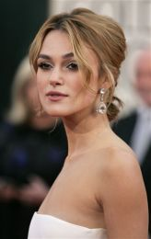
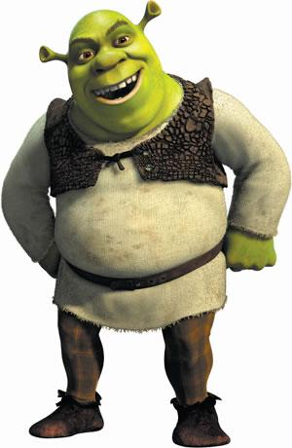
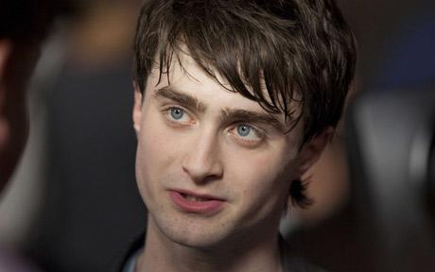
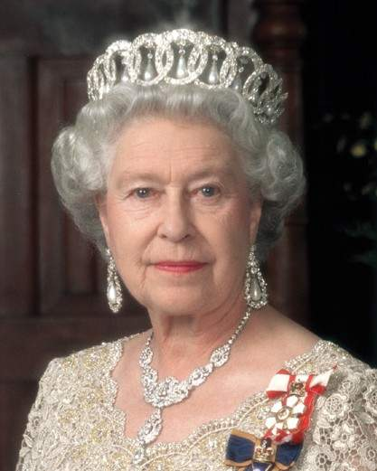
What do these people have in common?
© 2014 Brain Wrinkles

Slide 6
United Kingdom
© 2014 Brain Wrinkles

Slide 7
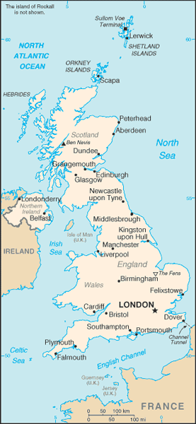
Location
The United Kingdom is a country of islands off the coast of mainland Europe.
It consists of England, Northern Ireland, Scotland, & Wales.
© 2014 Brain Wrinkles

Slide 8
Location
UK’s location makes it a hub for trade.
Across the English Channel is France, west is the Republic of Ireland, east is the Scandinavian Peninsula.
There are 10 major ports along UK’s coast!
© 2014 Brain Wrinkles

Slide 9
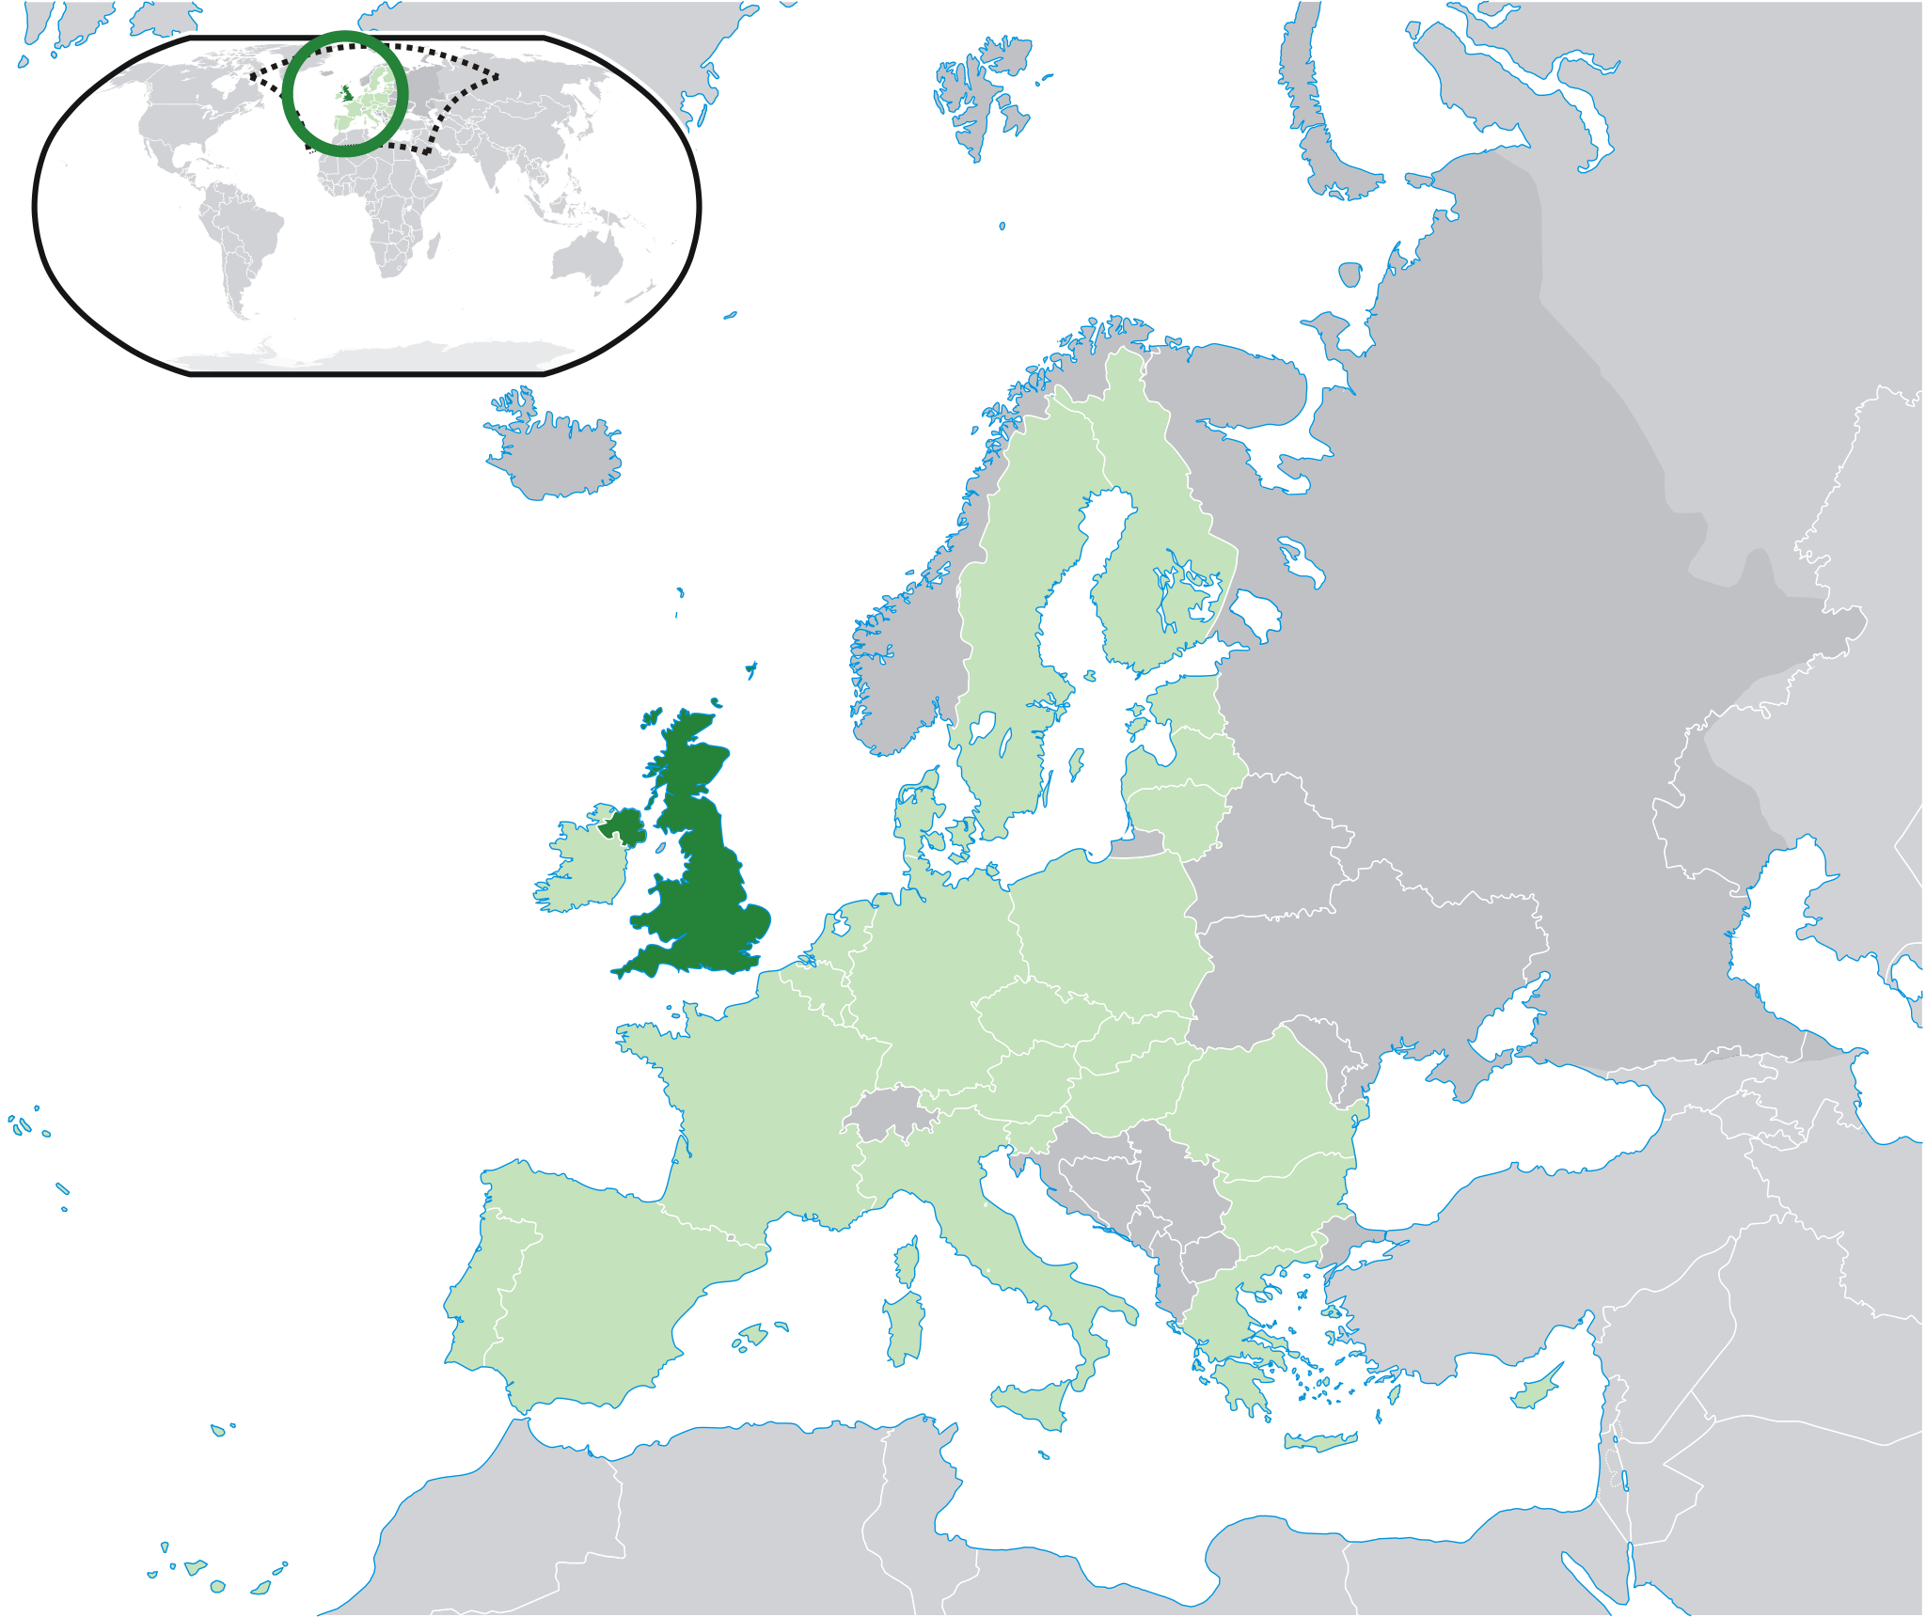
© 2014 Brain Wrinkles

Slide 10
Location & Trade
Location has helped the UK become an international banking & insurance center.
UK has more foreign bank branches than any country in the world.
Location on the Atlantic Ocean helps it trade with the US.
The United States is the UK’s #1 trading partner.
© 2014 Brain Wrinkles

Slide 11
Climate
UK has a mild climate with abundant rainfall throughout the year.
No section goes without rain for more than 2 weeks!
Winters are mild and wet; summers are warmest in the south.
The Gulf Stream crosses the Atlantic Ocean & warms the country, making the winters milder than other European countries.
© 2014 Brain Wrinkles

Slide 12
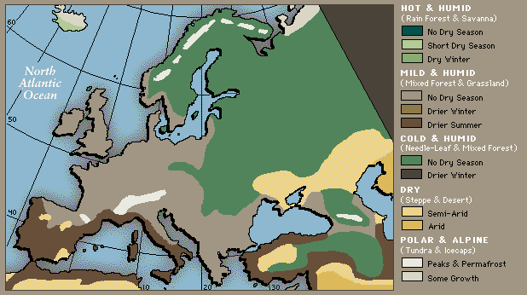
© 2014 Brain Wrinkles

Slide 13
Natural Resources
UK has deposits of coal, petroleum, natural gas, & iron ore.
These form the backbone of the country’s industry: auto production, steel manufacturing, & shipbuilding.
Other resources include: zinc, lead, gold, tin, limestone, salt, clay, gypsum, potash, sand, & slate.
© 2014 Brain Wrinkles

Slide 14
Natural Resources
Manufacturing is declining…
Natural resources are being used up and industry is changing to cleaner forms of energy.
Many people who once had jobs in mining and manufacturing are being retrained for jobs in service industries.
80% of the people work in service industries (tourism, health care, education, banking, & insurance).
© 2014 Brain Wrinkles

Slide 15
Natural Resources
Fishing is profitable along the shores of the UK.
Nearly 25% of the country has arable land (fertile; good for farming).
Over half of the land is used for farms.
© 2014 Brain Wrinkles

Slide 16
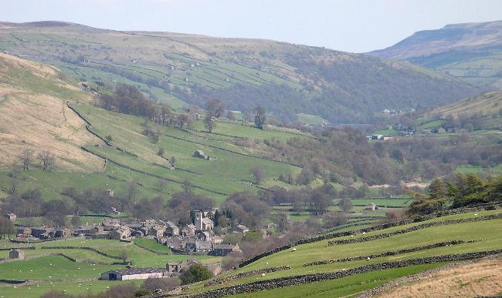
© 2014 Brain Wrinkles

Slide 17
Where People Live
About 60 million people live in the United Kingdom.
Land Area: 243,610 sq km
Around 90% of the UK’s people live in cities.
London alone has over 7 million people!
© 2014 Brain Wrinkles

Slide 18
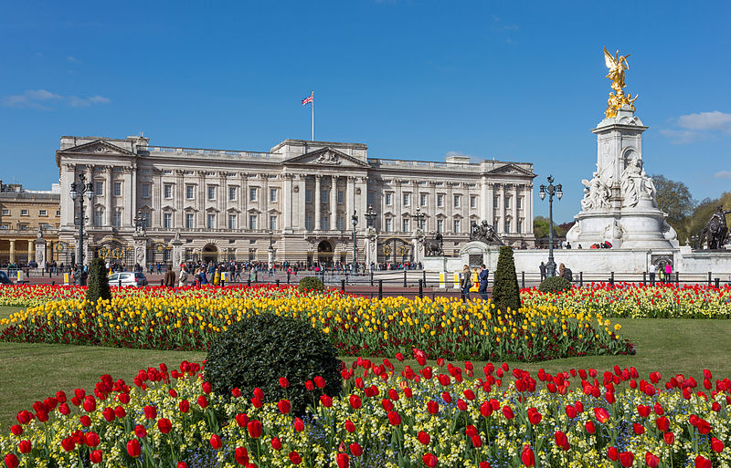
Buckingham Palace
© 2014 Brain Wrinkles

Slide 19
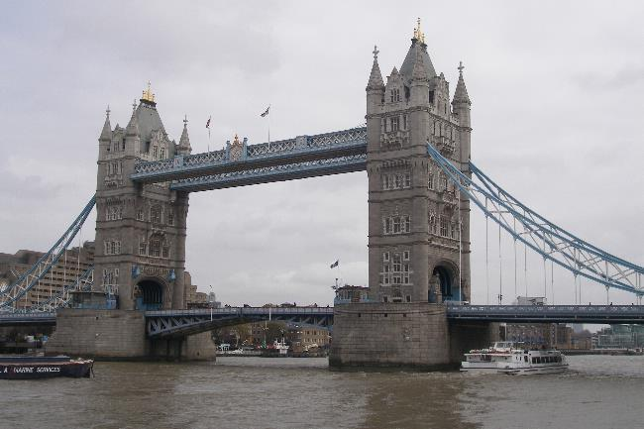
Tower Bridge
© 2014 Brain Wrinkles

Slide 20
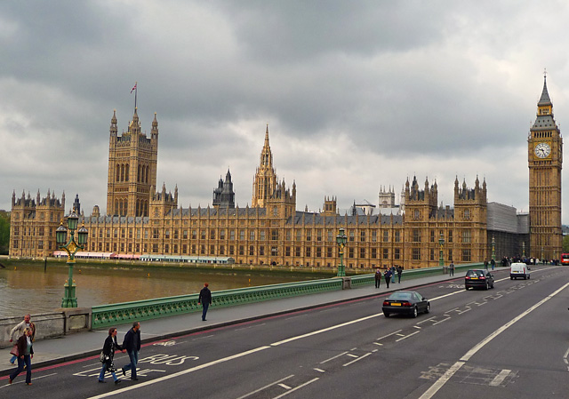
Big Ben and Parliament Building
© 2014 Brain Wrinkles

Slide 21
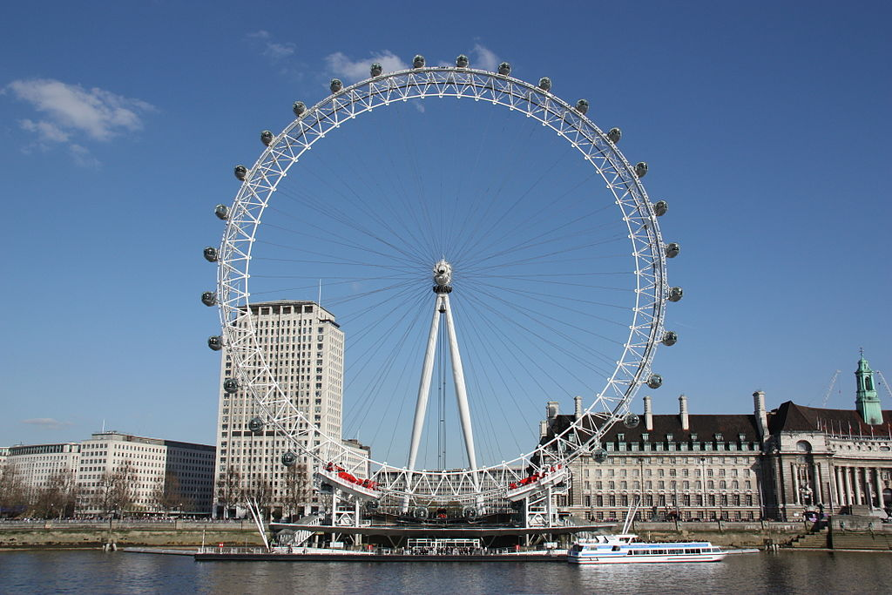
London Eye
© 2014 Brain Wrinkles

Slide 22
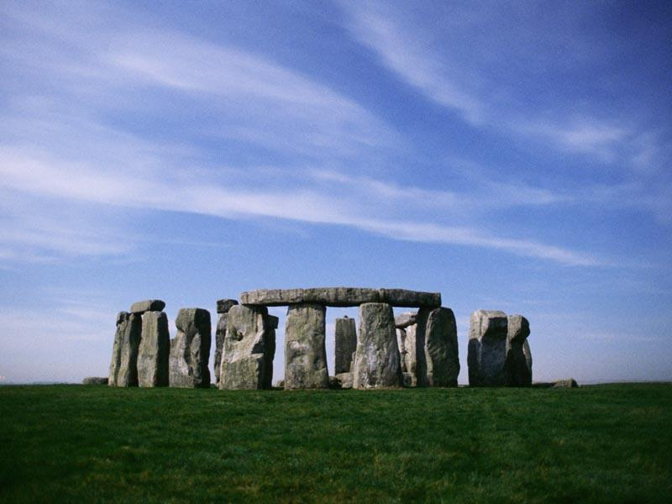
Stonehenge
© 2014 Brain Wrinkles

Slide 23
Italy
© 2014 Brain Wrinkles

Slide 24
Location
Italy is a long, boot-shaped peninsula surrounded on 3 sides by the Mediterranean Sea.
The Alps form Italy’s northern border.
The Apennine Mountains run from the Alps to the sea.
Two islands, Sardinia & Sicily, are part of the country.
© 2014 Brain Wrinkles

Slide 25
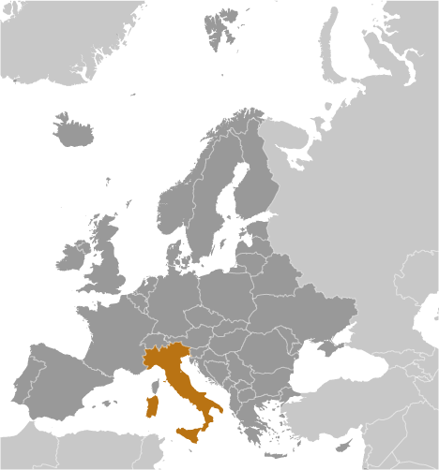
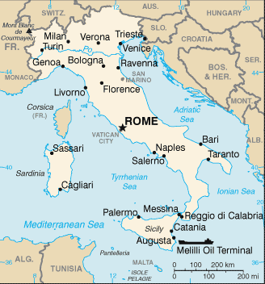
© 2014 Brain Wrinkles

Slide 26
Climate
Italy has a temperate (mild) climate with regional differences.
The coastal areas have mild winters and warm, dry summers.
Mountains have cold, wet, and snowy winters and humid summers.
© 2014 Brain Wrinkles

Slide 27
Natural Resources
Italy has few mineral resources: natural gas, marble, granite, coal, mercury, zinc, and potash.
Arable land is important (26% fertile land).
Small farms cover much of the country.
Grapes & olives are important crops.
There are more than 800 ports for fishing boats.
© 2014 Brain Wrinkles

Slide 28
Where People Live
Population: 58,000,000
Land Area: 301,340 sq km
7 out of 10 Italians live in urban areas (Rome, Naples, Milan, & Turin).
About half of the people live in the most northern 1/3rd of the country!
© 2014 Brain Wrinkles

Slide 29
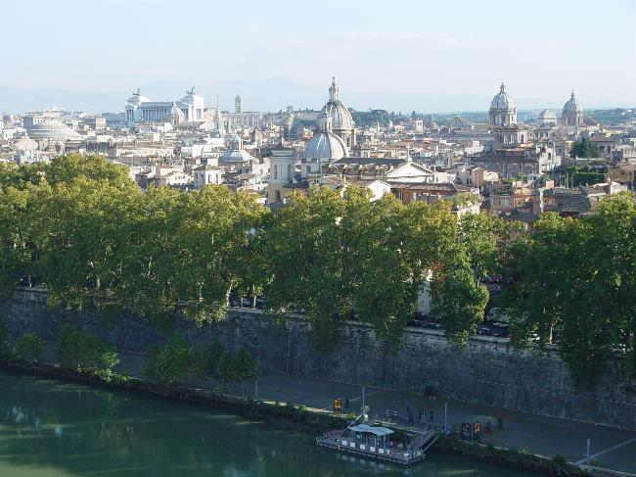
Rome, Italy
© 2014 Brain Wrinkles

Slide 30
Trading
Apennine Mountains are like a backbone across Italy.
They affect where people live & how they transport people and goods—make trading difficult.
Italy’s location on the Mediterranean Sea affects trade with other countries.
This makes trading easier.
Italy has a long history of shipping goods to countries in Africa, Europe, & Asia.
© 2014 Brain Wrinkles

Slide 31
Germany
© 2014 Brain Wrinkles

Slide 32
Location
Germany is in north-central Europe on the European Plain.
The southern region is mountainous; the central region is hilly and mountainous; the northern region is flat plains.
Germany contains the most important commercial waterway in Europe (Rhine River).
© 2014 Brain Wrinkles

Slide 33
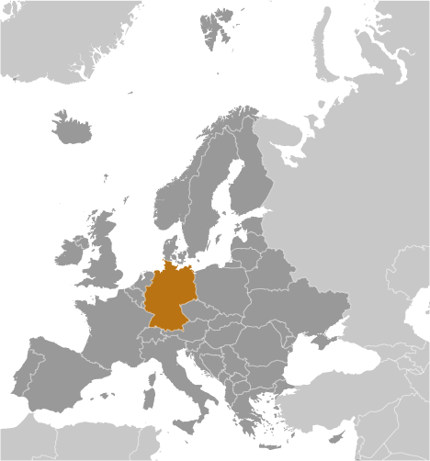
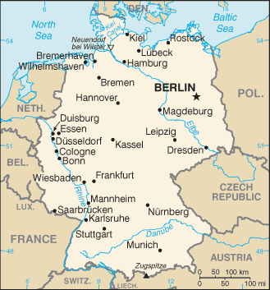
© 2014 Brain Wrinkles

Slide 34
Climate
Most of Germany has a mild, marine climate.
In the west, winters are mild and summers are cool, with rainfall year round.
The Gulf Stream warms the region, making the land warmer in the winter and cooling it off in the summer.
In the east, winters are very cold, while summers are very hot with long dry periods.
© 2014 Brain Wrinkles

Slide 35
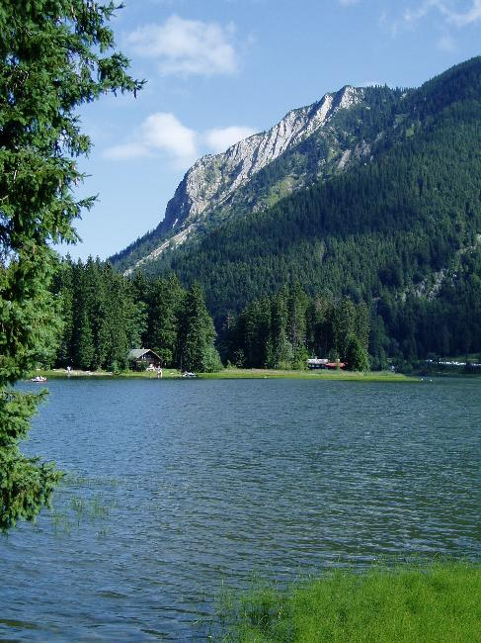
© 2014 Brain Wrinkles

Slide 36
Natural Resources
Germany has many natural resources: iron ore, coal, potash, uranium, nickel, natural gas, & copper.
Timber is also a resource, but much of the forests in the north have been cut down for farms & towns.
About 33% of the land is arable.
© 2014 Brain Wrinkles

Slide 37
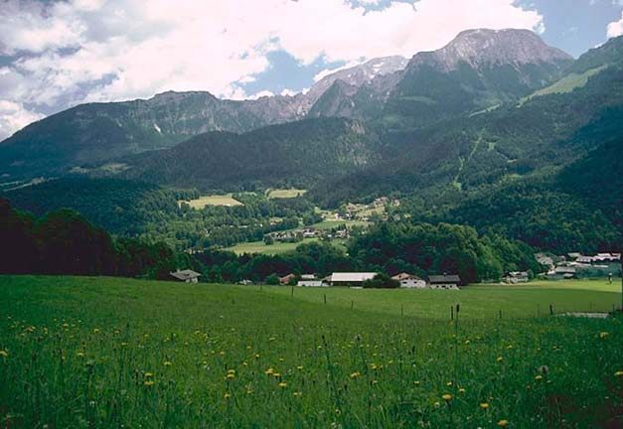
© 2014 Brain Wrinkles

Slide 38
Where People Live
Population: 82,000,000
Land Area: 357,022 sq km
Germany is one of the most densely populated countries in Europe.
85% of the population lives in urban areas (cities).
Berlin is the largest city & the capital.
© 2014 Brain Wrinkles

Slide 39
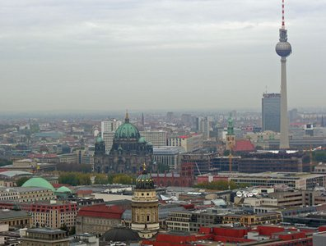
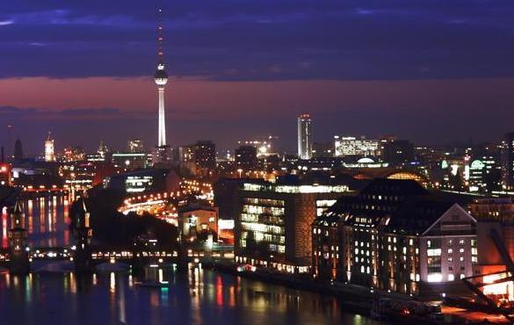
© 2014 Brain Wrinkles

Slide 40
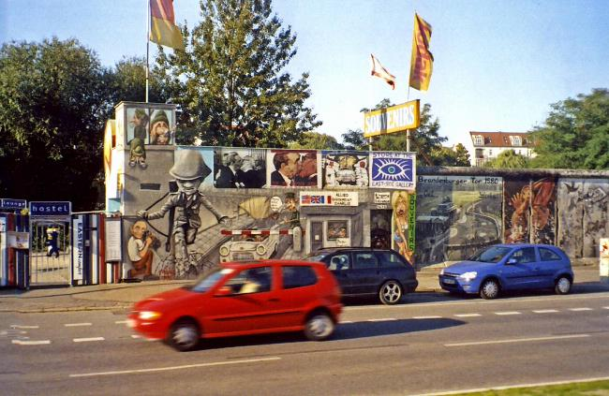
© 2014 Brain Wrinkles

Slide 41
Trade
Rhine River is very important for trade.
Many German cities lie along the Rhine.
Location gives those cities an excellent way to transport goods & people.
© 2014 Brain Wrinkles

Slide 42
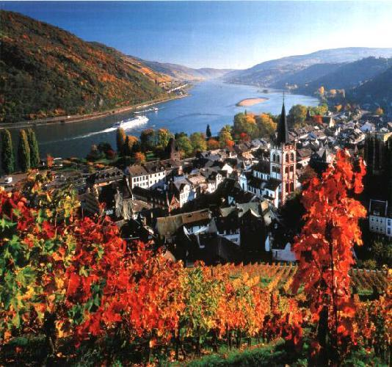
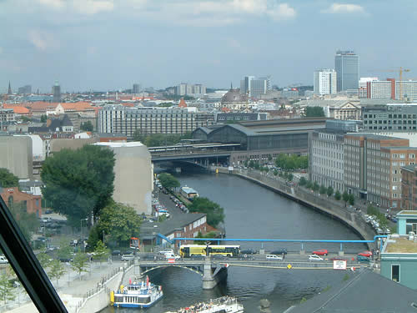
© 2014 Brain Wrinkles

Slide 43
Russia
© 2014 Brain Wrinkles

Slide 44
Location
Russia spans 2 continents: Europe & Asia.
It is so wide that a train trip across takes a week!
Russia shares a border with 15 countries.
The eastern side is bounded by Pacific Ocean, and the northern side is bounded by Arctic Ocean.
At its closest point, Russia & US are only 3 miles apart across Bering Strait!
© 2014 Brain Wrinkles

Slide 45
Location & Trade
European Russia is mostly landlocked (difficult for trading via ship)
2 exceptions: Murmansk & St. Petersburg
© 2014 Brain Wrinkles

Slide 46
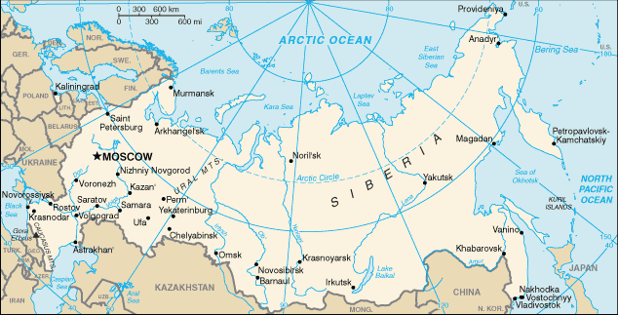
© 2014 Brain Wrinkles

Slide 47
Climate
Russia only has 2 seasons—winter and summer.
The average yearly temperature is below freezing!
Asian Russia (Siberia) has the most extreme climate:
lows -40 degrees & highs over 90 degrees
73% of population lives in European Russia (because it’s warmer).
© 2014 Brain Wrinkles

Slide 48
Natural Resources
Vast forests for lumber are found here, but many have been cleared away for cities on the European side.
Deposits of gold, aluminum ore, coal, & iron are found in the Ural Mountains.
Volga River (largest river in Europe) is a major source of hydroelectric power.
© 2014 Brain Wrinkles

Slide 49
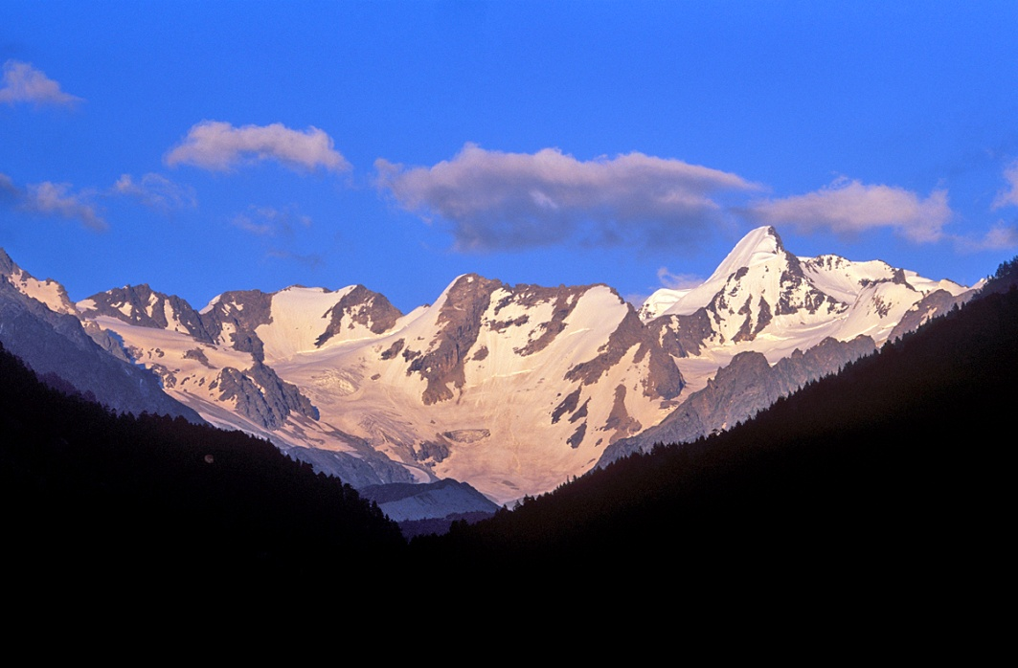
Natural Resources
Russia’s large size, rugged terrain, and cold climate make it difficult for Russians to use their resources.
© 2014 Brain Wrinkles

Slide 50
Where People Live
Russia is one of the most populous countries in the world, with 145.5 million people.
Land Area: 17,098,242 sq km
Most people live WEST of the Ural mountains, where the climate is mildest and the land is the most fertile.
© 2014 Brain Wrinkles

Slide 51
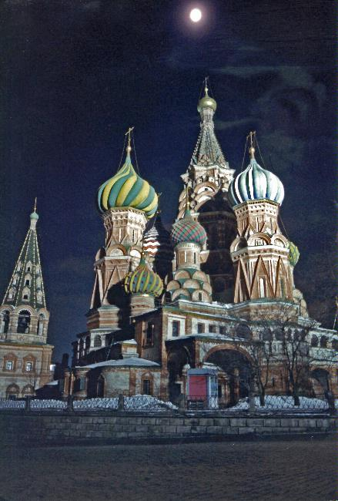
St. Basil’s
Cathedral
© 2014 Brain Wrinkles

Slide 52
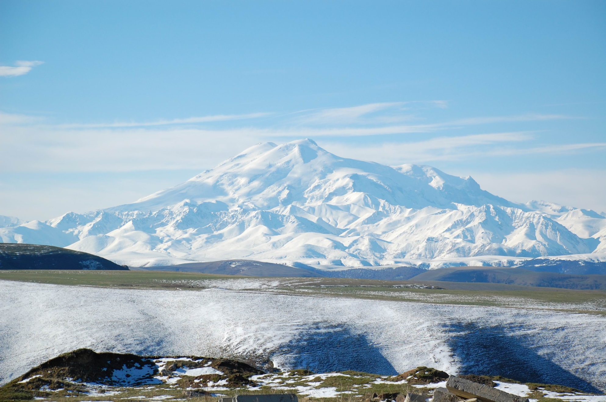
Mt. Elbrus
© 2014 Brain Wrinkles

Slide 53
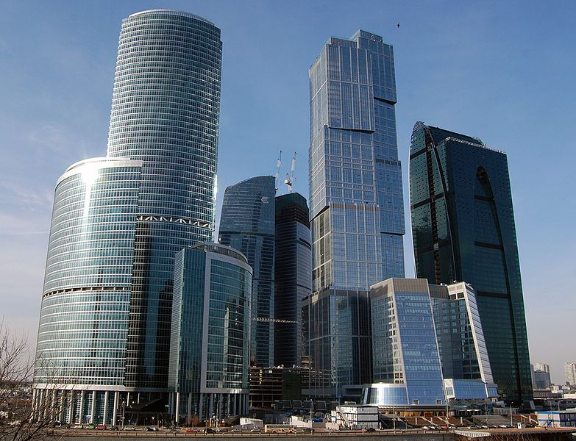
Moscow Business Center
© 2014 Brain Wrinkles

Slide 54
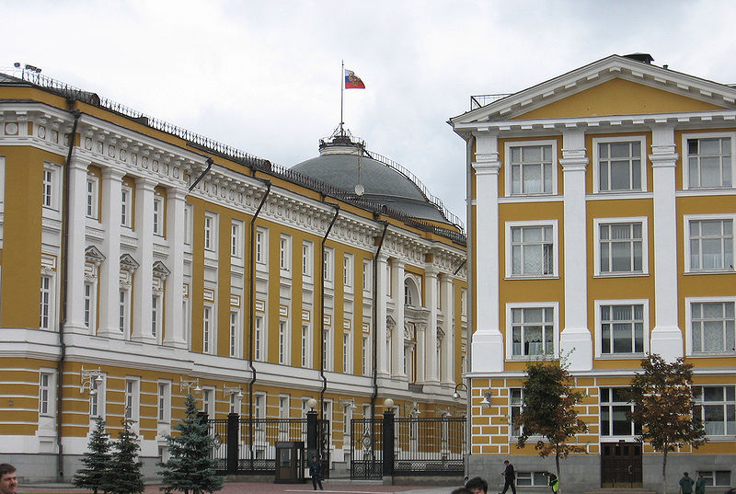
Kremlin Senate
© 2014 Brain Wrinkles

Slide 55
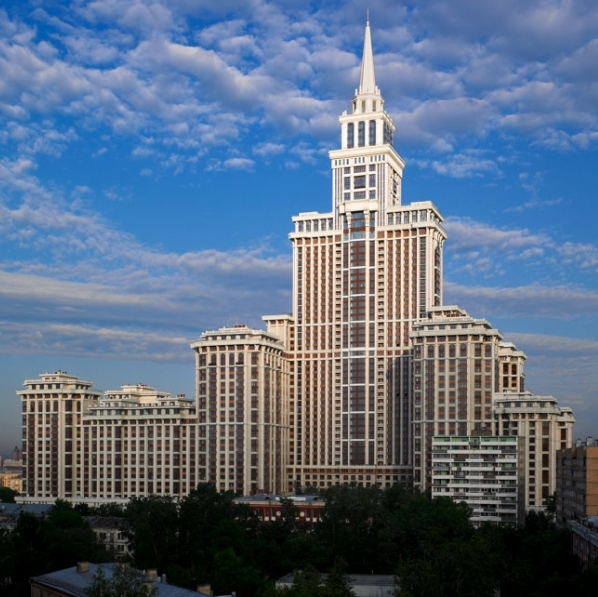
Triumph Palace
© 2014 Brain Wrinkles

Slide 56
Teacher Info – Pack Your Bags
Print off copies of the Suitcase handout for each student.
Project the directions slide onto the board while students work.
They will choose one of the 4 countries to visit, and they will draw 5 things that they would take to the country inside the suitcase.
© 2014 Brain Wrinkles

Slide 57
Pack Your Bags!
Which country would you most like to visit: UK, Russia, Italy, or Germany?
Inside of the suitcase, draw 5 things that you will take with you to this country.
Think about the location, climate, physical features, and natural resources of the country.
Next, include a brief description of why you chose to bring that particular item.
© 2014 Brain Wrinkles

Slide 58
© 2014 Brain Wrinkles

Slide 59
Teacher Info – Real Estate Advertisement
Print out copies of the Real Estate Advertisement handout for each student.
Project the directions slide onto the board.
The students will choose land in one of the 4 countries and try to “sell” the land.
© 2014 Brain Wrinkles

Slide 60
Real Estate Advertisement
Choose one of the countries that we are studying.
Create an advertisement for land that is available to settle within the country.
Write a testimonial statement that promotes your land, as well as brief descriptions of climate, land features, and natural resources in the country.
You should also draw illustrations of the land, climate, landforms, and resources.
© 2014 Brain Wrinkles

Slide 61
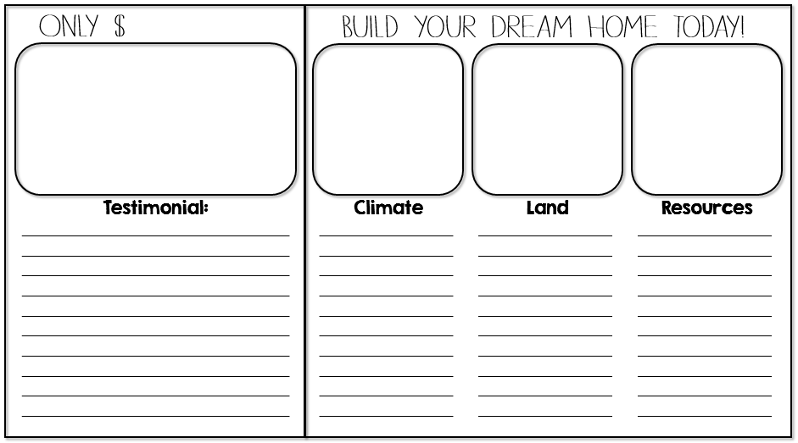
© 2014 Brain Wrinkles

Slide 62
Teacher Info – Fieldtrip Wish List Ticket Out the Door
Have students write a quick note to persuade you to take them on a “fieldtrip” to one of the 4 countries. If time, they can draw an illustration to accompany the note.
© 2014 Brain Wrinkles

Slide 63
Fieldtrip Wish List
Fieldtrip Wish List
Wouldn’t it be awesome to take a fieldtrip to one of the countries that we are studying? Write me a note to try and convince me to take your class to this country. Include at least THREE reasons why we should go there. Also, draw an illustration to go with your note.
Wouldn’t it be awesome to take a fieldtrip to one of the countries that we are studying? Write me a note to try and convince me to take your class to this country. Include at least THREE reasons why we should go there. Also, draw an illustration to go with your note.
From the Desk of…
From the Desk of…
© 2014 Brain Wrinkles
© 2014 Brain Wrinkles

