Slide 1
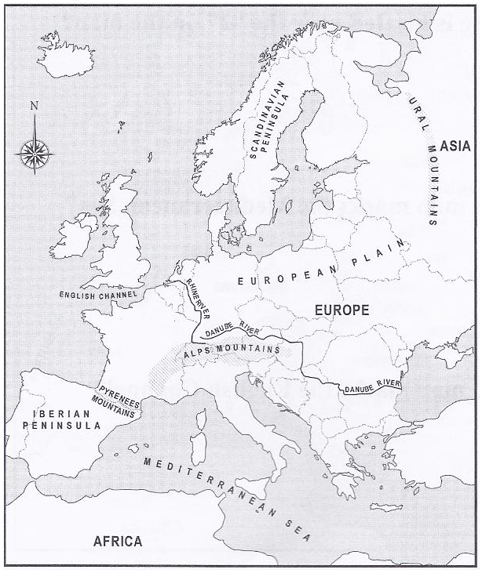
Physical Map of Europe

Slide 2
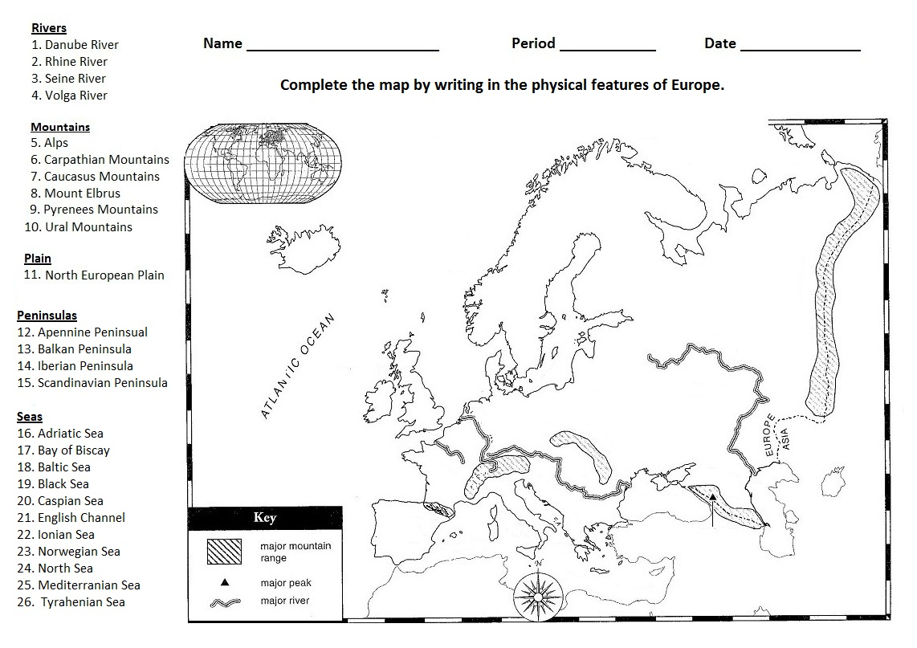

Slide 3
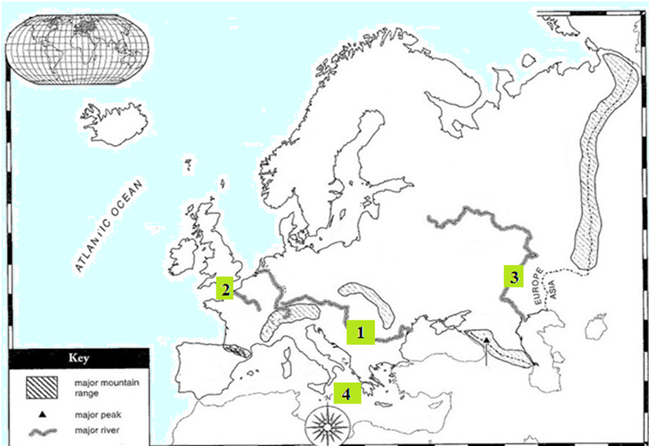
Important Bodies of Water in Europe
SS6G8 The students will locate selected features of Europe: a. Locate on a world and regional political-physical map: Danube River, Rhine River, English Channel, Mediterranean Sea, European Plain, the Alps, Pyrenees, Ural Mountains, Iberian Peninsula, Scandinavian Peninsula

Slide 4
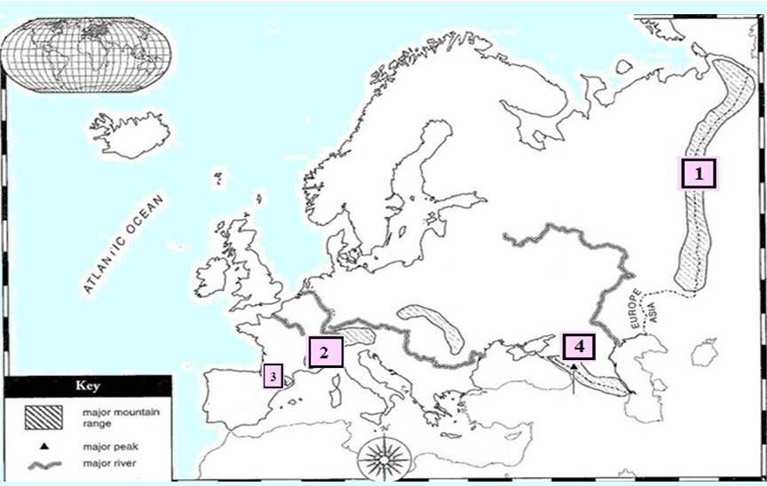
Important Mountains of Europe Quiz
SS6G8 The students will locate selected features of Europe: a. Locate on a world and regional political-physical map: Danube River, Rhine River, English Channel, Mediterranean Sea, European Plain, the Alps, Pyrenees, Ural Mountains, Iberian Peninsula, Scandinavian Peninsula

Slide 5
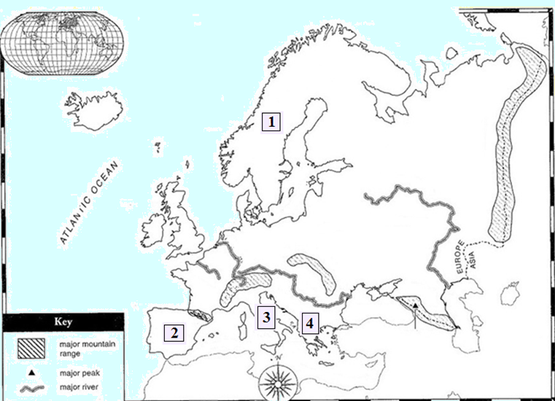
Important Peninsulas of Europe quiz
SS6G8 The students will locate selected features of Europe
a. Locate on a world and regional political-physical map: Danube River, Rhine River, English Channel, Mediterranean Sea, European Plain, the Alps, Pyrenees, Ural Mountains, Iberian Peninsula, Scandinavian Peninsula

Slide 6
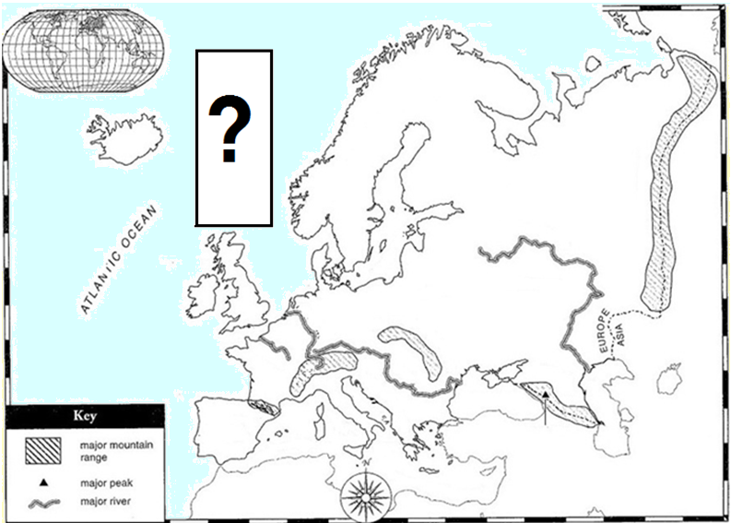
The North European Plain
SS6G8 The students will locate selected features of Europe: a. Locate on a world and regional political-physical map: Danube River, Rhine River, English Channel, Mediterranean Sea, European Plain, the Alps, Pyrenees, Ural Mountains, Iberian Peninsula, Scandinavian Peninsula

Slide 7
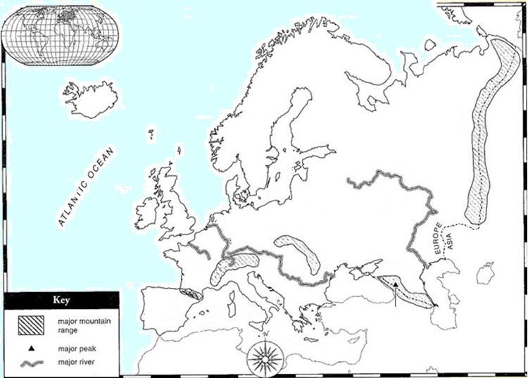
The North European Plain
SS6G8 The students will locate selected features of Europe
a. Locate on a world and regional political-physical map: Danube River, Rhine River, English Channel, Mediterranean Sea, European Plain, the Alps, Pyrenees, Ural Mountains, Iberian Peninsula, Scandinavian Peninsula

Slide 8
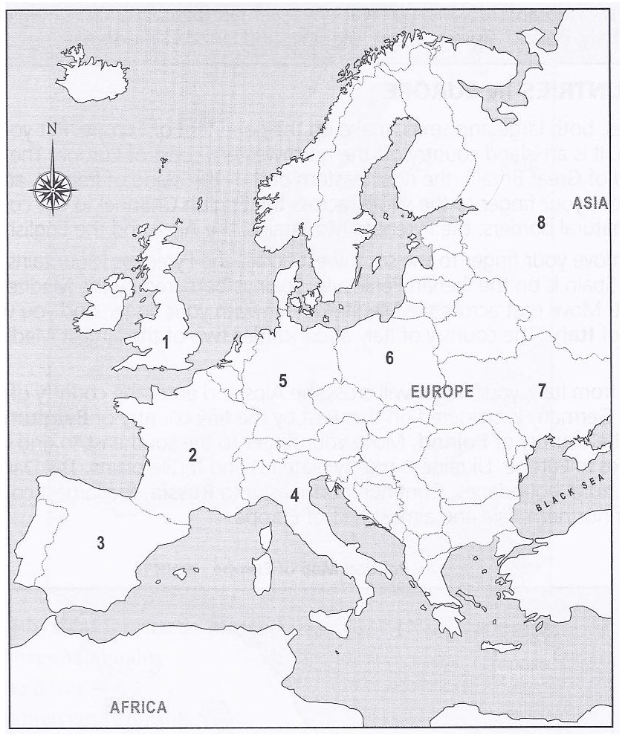
Countries of Europe Quiz
Sally’s Father Bought Giant Purple Umbrellas

Slide 9
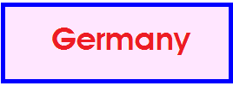
Countries of Europe Quiz
Sally’s Father Bought Giant Purple Umbrellas

