Slide 1
Australia’s
Government
A Federal Parliamentary Democracy

Slide 2
Standards
SS6CG6 The student will compare and contrast various forms of government.
a. Describe the ways government systems distribute power: unitary, confederation, and federal.
b. Explain how governments determine citizen participation: autocratic, oligarchic, and democratic.
c. Describe the two predominant forms of democratic governments: parliamentary and presidential.
SS6CG7 The student will explain the structure of the national government of Australia.
a. Describe the federal parliamentary democracy of Australia, distinguishing form of leadership, type of legislature, and the role of the citizen in terms of voting and personal freedoms.

Slide 3
Teachers
Print off the following slide for each student.
Have the students fold the paper along the long line. They will cut along the lines of the right side (between each topic) so that they are flaps.
The students will write facts/definitions inside of each flap while discussing the presentation.

Slide 4
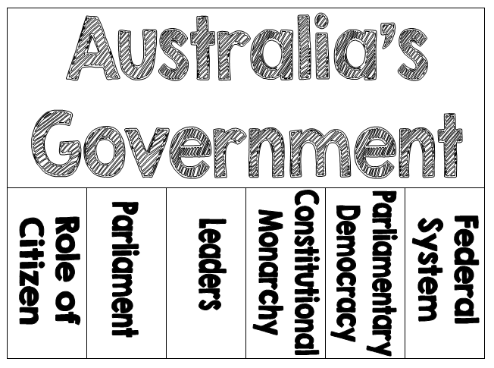

Slide 5
Teachers
Print off the following slide for each student.
Have the students complete the Anticipation Guide BEFORE the presentation to gauge what they already know about Australia’s government.
*There are also economic-related questions in this guide, but the notes in this presentation are government-related only. I have an “Australia’s Economy” file in my store if you’re interested.

Slide 6
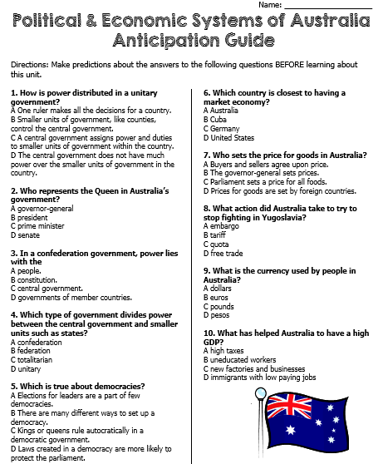

Slide 7
Let’s Review
Government Systems – Who has the power?
Unitary--power is held by one central authority
Confederation--association of independent states that agree to certain limitations on their freedoms by joining together
Federal--power is divided between central authority & several regional authorities
Which system does Australia have?

Slide 8
Let’s Review
Government Types – how do citizens participate?
Autocracy-- 1 person possesses unlimited power & citizens have limited role in government
Oligarchy-- small group exercises control & citizens have limited role in government
Democracy--supreme power is vested in the people & exercised by them directly or indirectly though a system of representation involving free elections
Which type does Australia have?

Slide 9
Let’s Review
Two Types of Democratic Governments:
Parliamentary– citizens elect members of Parliament, and then the members select the leader
Leader works with or through the legislature
Presidential--system of government in which the leader is constitutionally independent of the legislature; citizens directly elect leader
Leader works separate from legislature
Which type does Australia have?

Slide 10
Australia’s
Government
Federation (federal system)
Constitutional Monarchy
Parliamentary Democracy

Slide 11
Federal System
Australia has a federal system, which means that the national government and the state governments SHARE power.
There are 6 states and 2 territories in Australia.

Slide 13
Constitutional Monarchy
Constitutional Monarchy- A monarch inherits the right to rule but is limited by laws and a law making body elected by the people.
Australia’s constitution lists the powers of the government.
The British monarchy, a king or queen, is the head of state. However, since the monarchy does not live in Australia, he or she chooses a governor-general to act in his or her place…

Slide 14
Leadership
1. Head of State: Monarch of the United Kingdom (presently, Queen Elizabeth II); little political power
2. Governor General: stands in for the monarch
3. Prime Minister: holds the most political power; works closely with the legislature

Slide 15
How Leaders Are Chosen
Governor General: appointed by the monarch on the advice of the Prime Minister; the Constitution does not set a length of term but most serve for 5 years
Prime Minister: is the leader of the majority party in the House of Representatives; indirectly elected by the people

Slide 16
Legislature
Legislature = the central authority of a government
Australia’s legislature is called Parliament.
The citizens of Australia vote for members of Parliament.
Members of Parliament belong to many different political parties.

Slide 17
Parliamentary
Democracy
Whichever political party has the most members in the legislature selects the Prime Minister.
This is the major difference between a Presidential Democracy and a Parliamentary Democracy!
Parliamentary Democracy – legislature (Parliament) chooses Head of Government (Executive Leader)
Citizens vote for members of Parliament, members choose the Prime Minister.

Slide 18
Role of the Citizen
Citizens who are 18 - 70 are required by law to vote.
As a democracy, its citizens must participate in voting and elections:
They elect members of Parliament.
They elect regional government officials (state governors).
They also vote on specific issues.

Slide 19
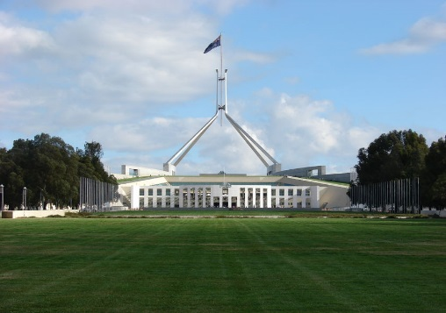
HOUSE OF REPRESENTATIVES

Slide 20
Australia’s Economy
It’s one of the most “free” economies in the world.
Because there are no truly pure Market economies, Australia is said to have a Mixed economy.
It’s actually very close to Market because there are very few economic “rules” in place by the government.
Australia’s government does not own major industries or businesses.
Prices are set by the agreement of buyers and sellers rather than by government rules.

Slide 21
Economic Continuum
Command
Market
Cuba
Russia
Germany
UK
US
Australia

Slide 22
Australia’s Economy
Australia is considered close to having a Market economy because:
Businesses operate without too many rules from the government.
People are free to start a business and can do so quickly.
Courts use the laws of Australia to protect the property rights of citizens.

Slide 23
Australia’s Economy
In Australia, people are free to own their own businesses and property.
They decide what they want to produce.
Buyers and sellers are able to agree on prices, and competition between sellers helps to keep the prices good for buyers.
Business owners and consumers can depend on good laws to protect them.
The courts are considered fair and honest.
It is very easy to start a business in Australia – the paperwork usually takes less than a week!

Slide 24
Australia’s GDP
Australia’s GDP is $1.542 trillion (US dollars).
The GDP per capita (value of goods and services produced per person) is $43, 300.
This is a very high number; they are ranked 19th in the world!
Australia has such a high GDP because of the abundance of the four factors of economic growth within the country:
Natural Resources
Human Capital
Capital Goods
Entrepreneurship

Slide 25
Australia’s Natural Resources
Australia’s arable land is a valuable resource.
Farmers grow a variety of crops.
The land also provides pastures for beef cattle (an important export).
What percentage of the land is arable?
6.16%
What are the major agricultural products?
wheat, barley, sugarcane, fruits; cattle, sheep, poultry

Slide 27
Australia’s Natural Resources
Minerals are a major export: coal, iron ore, copper, tin, gold, silver, uranium, nickel, tungsten, mineral sands, lead, zinc, diamonds, natural gas, & petroleum
Australia is the world’s leader in bauxite, which is used to make aluminum, and coal.
The sales of natural resources bring in money from all over the world.

Slide 28
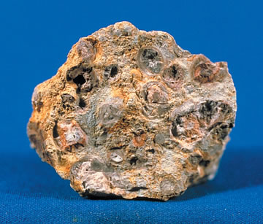
Bauxite Mining in Western Australia

Slide 29
Capital Goods in Australia
Australia’s businesses use advanced technology to make their companies work more efficiently.
If a company does not keep its machinery up-to-date, other companies will be able to produce similar goods for a better price.

Slide 30
Human Capital in Australia
Australia invests heavily in human capital:
Children are required to attend school from 6 to 18.
Taxpayers pay for schooling for all children.
Literacy rate is nearly 100%.
Workforce is well-trained and well-educated.
Healthcare system is very good.
All of these factors improve Australia’s standard of living: one of the highest in the world!

Slide 31
Australia’s Literacy Rate
What percentage of the population over the age of 15 can read and write?
99%
How long are students required by law to stay in school?
18 years

Slide 32
Australia’s Entrepreneurs
Australia is a world leader in entrepreneurship.
1 in 12 adults owns his own business.
Laws in Australia are good for business: protect entrepreneurs & their property, easy to start a business, few rules to restrict businesses
Entrepreneurs are good for Australia.
Businesses keep economy moving & provide jobs for workers.

Slide 33
Economic Struggles
Even though Australia has one of the highest standards of living in the world, it still struggles with some economic problems.
There is still poverty:
The worst conditions are among the Aborigines.
Life expectancy of Aborigines is much lower than other Australians.
Aborigines tend to earn less income and do not have as good a system of healthcare.
What percentage of Australia’s population is unemployed?
5.2%

Slide 34
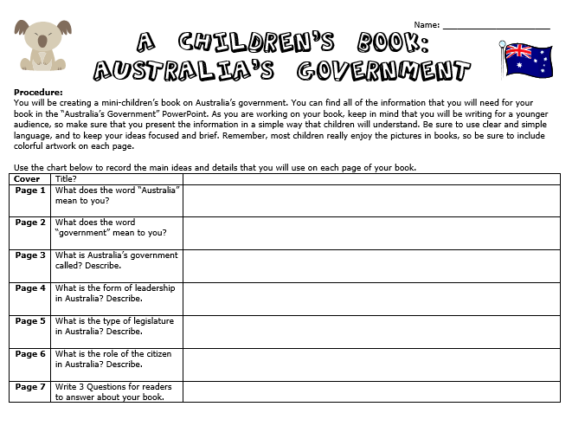

Slide 35
