Slide 1
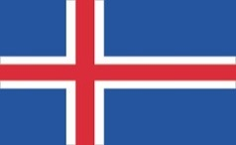
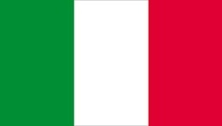
Geography of Europe REVIEW

Slide 2
Essential Question: Where are the major physical features and nations of Europe located?
Standards:
SS6G8a. Locate on a world and regional political- physical map: the Danube River, Rhine River, English Channel, Mediterranean Sea, European Plain, the Alps, Pyrenees, Ural Mountains, Iberian Peninsula, and Scandinavian Peninsula.
SS6G8b. Locate on a world and regional political-physical map the countries of Belgium, France, Germany, Italy, Poland, Russia, Spain, Ukraine, and United Kingdom.

Slide 3
Teachers: Use some type of method to check student responses. Either paper/pencil, slipcovers, or some form of student response tools (Plicker Cards, ABCD Answer Cards, etc.)

Slide 4
European Physical Features

Slide 5
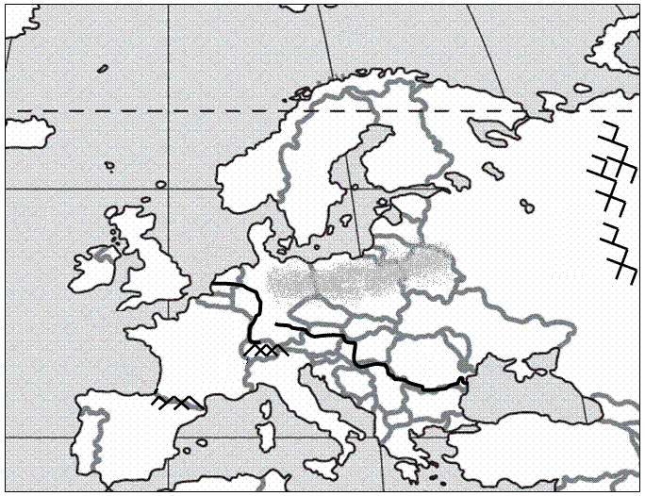
1
Notes:
Mediterranean Sea

Slide 6
2
Notes:
Iberian Peninsula

Slide 7
3
Notes:
Pyrenees

Slide 8
4
Notes:
Alps

Slide 9
5
Notes:
English Channel

Slide 10
6
Notes:
Rhine River

Slide 11
7
Notes:
European Plain

Slide 12
8
Notes:
Danube River

Slide 13
9
Notes:
Ural Mountains

Slide 14
10
Notes:
Scandinavian Peninsula

Slide 15
European Nations on a Political Map

Slide 16
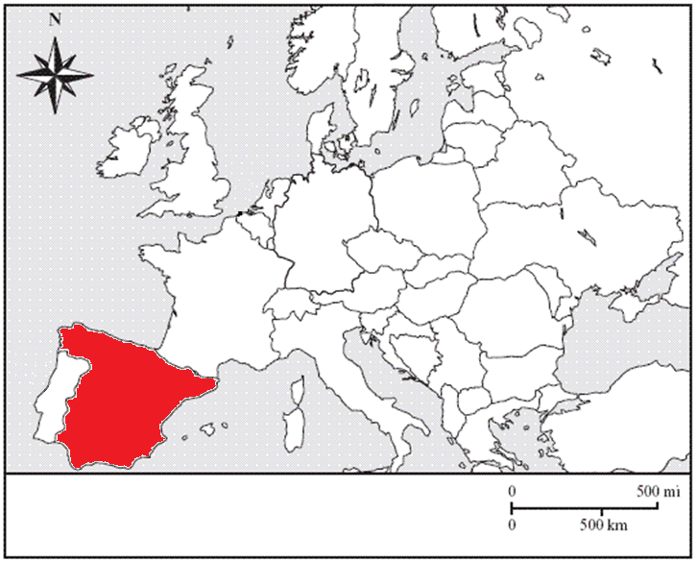
11
Notes:
Spain

Slide 17
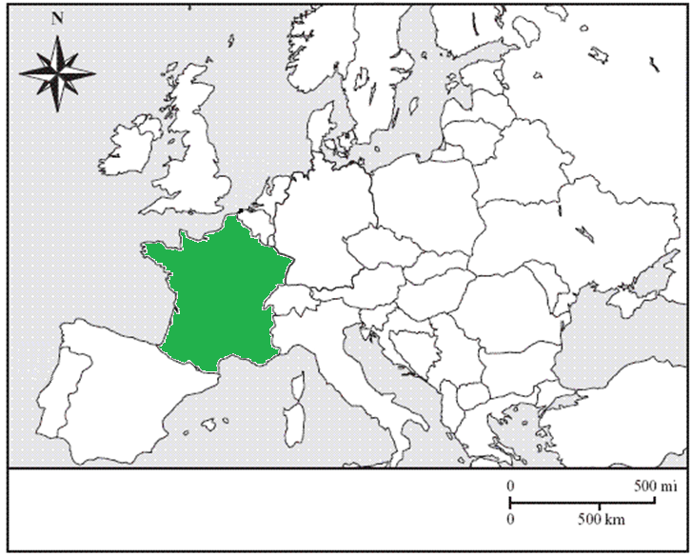
12
Notes:
France

Slide 18
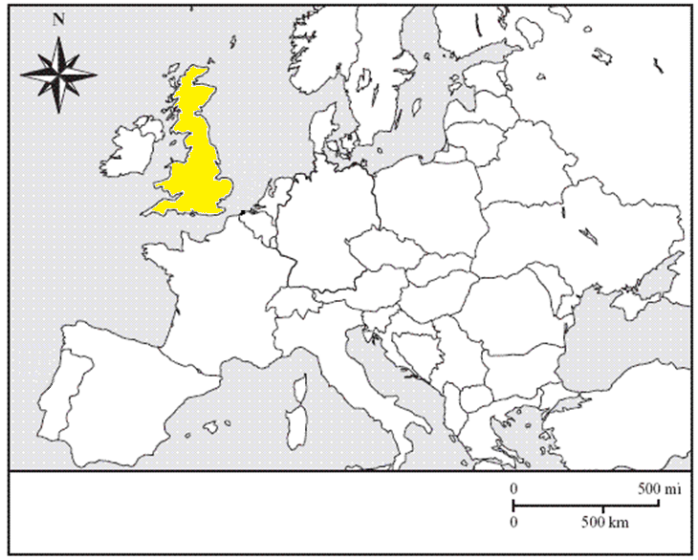
13
Notes:
United Kingdom

Slide 19
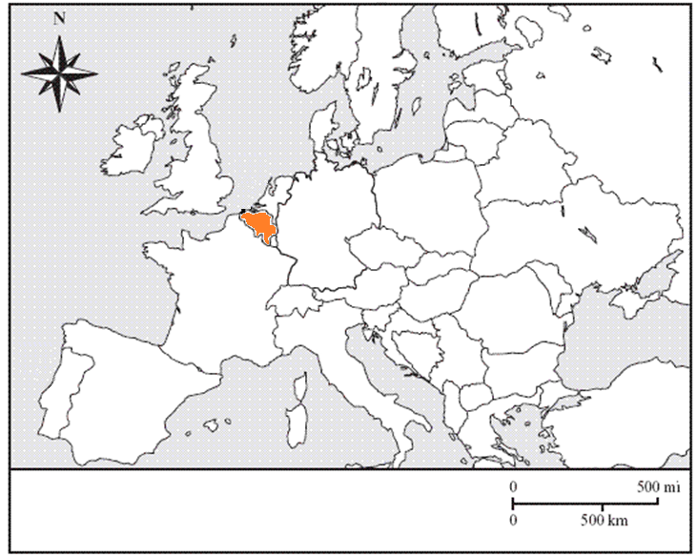
14
Notes:
Belgium

Slide 20
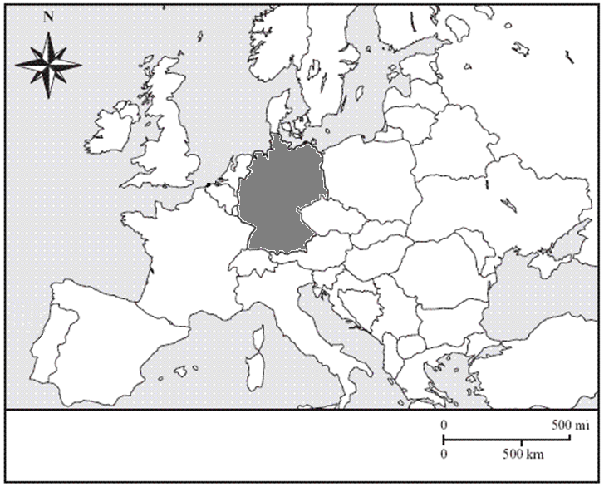
15
Notes:
Germany

Slide 21
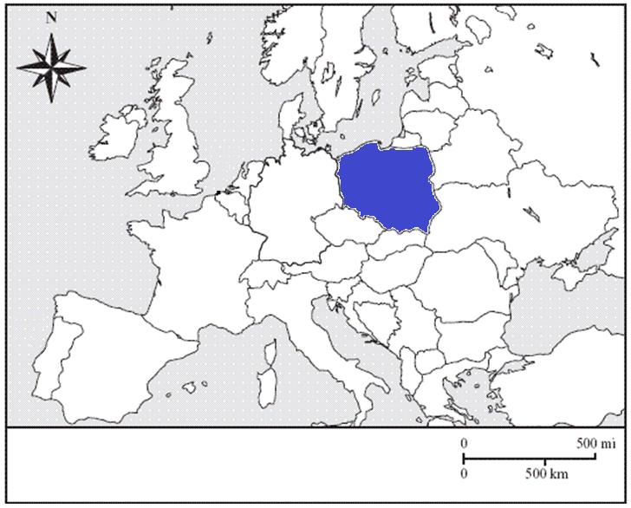
16
Notes:
Poland

Slide 22
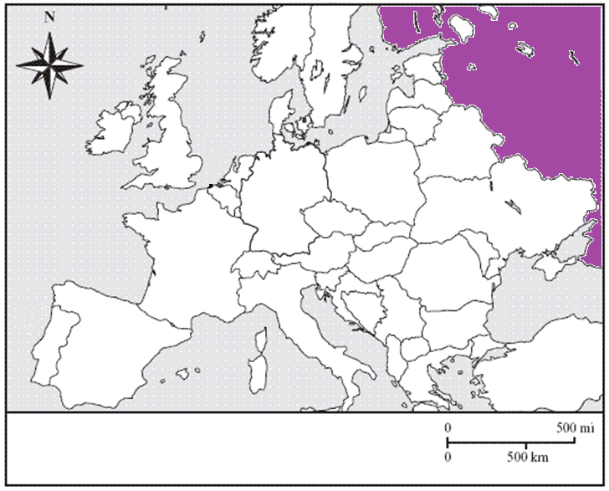
17
Notes:
Russia

Slide 23
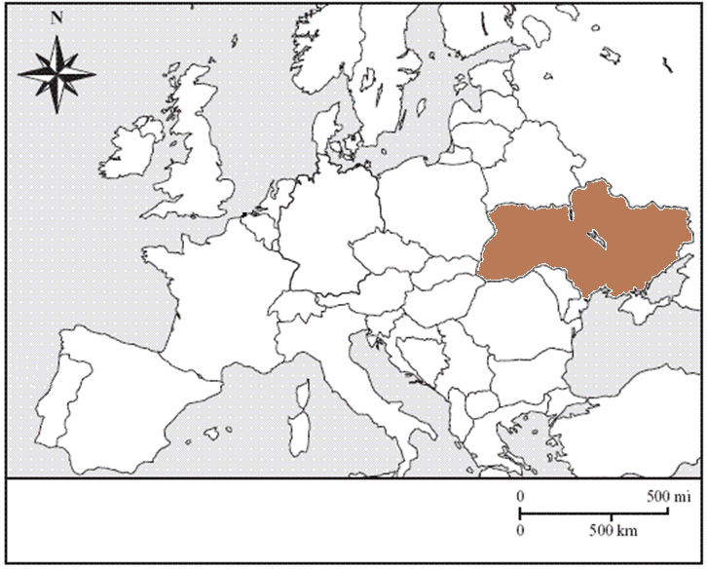
18
Notes:
Ukraine

Slide 24
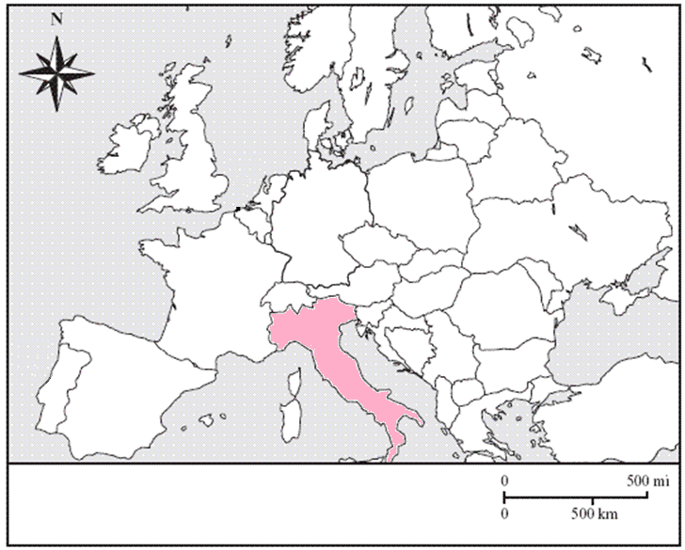
19
Notes:
Italy

Slide 25
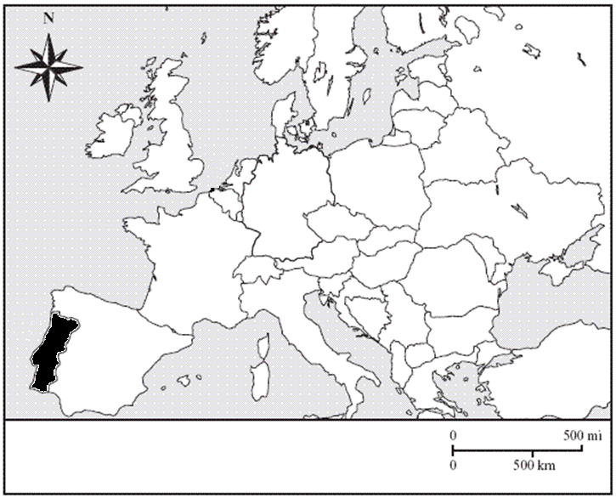
20
Notes:
Portugal

