Slide 1
Australia Geography

Slide 2
SS6G12 The student will be able to locate selected features of Australia
Complete your blank map from page 679 in the book. There are 10 items to label.
Great Barrier Reef
Tasmania
Great Dividing Range
Outback
Uluru/Ayers Rock
Indian Ocean
Pacific Ocean
Coral Sea
Great Victoria Desert
Canberra

Slide 3
Australia Political Map

Slide 4
Australia Physical Features

Slide 5
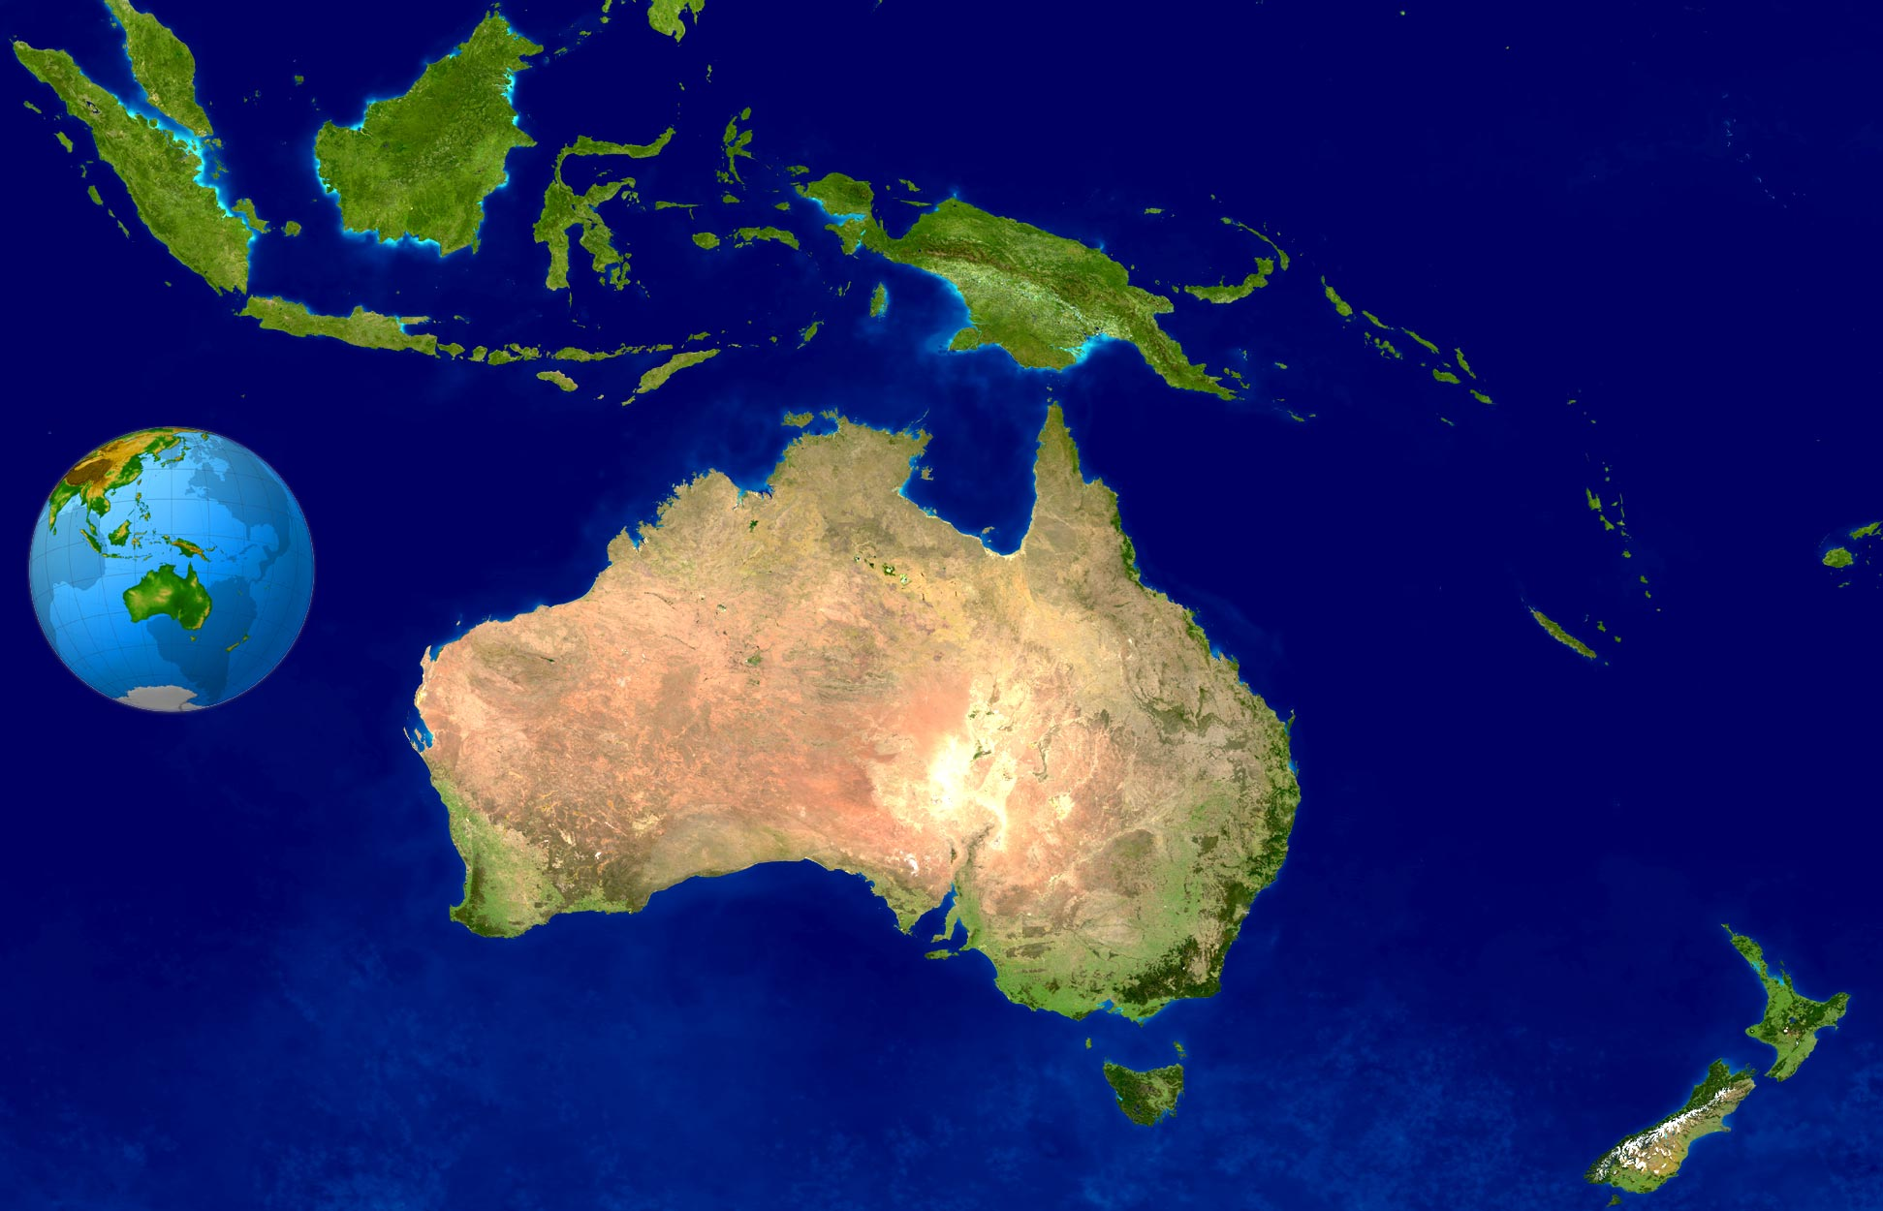
Australia is unique. It is both a country and a continent.
Physical map of Australia

Slide 6
Physical Geography
The largest part of Australia is made up of an interior dry area called the Outback. This vast arid plain, or desert in the middle section of Australia gets very little precipitation.

Slide 7
Most Australians live along the southeastern and southwestern coasts. The climate is milder and it gets more precipitation.

Slide 9
In the northern part of Australia, the climate is more varied with a mostly tropical climate. You will find swamps, rainforests, mangroves, grasslands, and even a desert

Slide 10
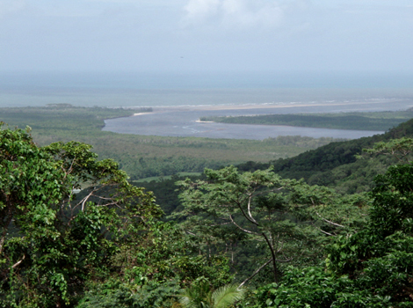
Daintree Rainforest

Slide 11
On the northeastern coast of Australia is the Great Barrier Reef in the Coral Sea. It is the largest reef system in the world, stretching more than 1,200 miles, and creating habitats for 1,500 species of fish and the largest collection of coral in the world.

Slide 13
In central Australia, a large monolith of sandstone stands 12 stories tall out from the flat, dry lands. It is called _Uluru by the Aborigines, and Ayers Rock by the European settlers. It is a sacred, religious place for Aborigines.

Slide 14
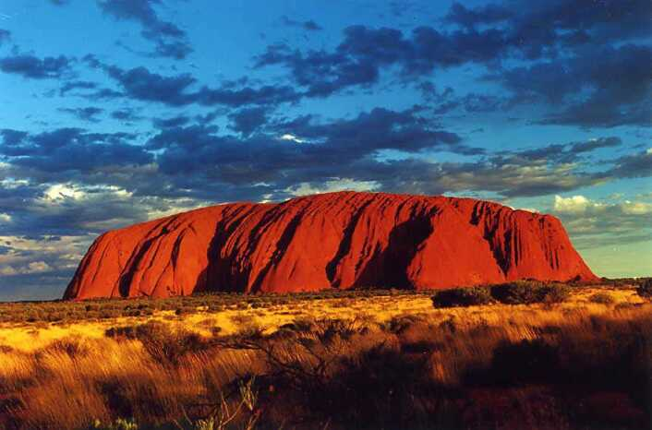

Slide 15
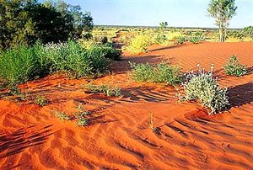
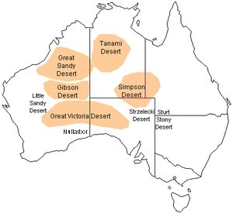
In the southwestern part of Australia is a large, desert region called the Great Victoria Desert. It receives only 8-10 inches of precipitation each year and is so hot and dry that few people live in that vast region of over 160,000 square miles

