Slide 1
How are tariffs, quotas, and embargos barriers to trade?
SS6E2b, SS6E6a, SS6E9c
Compare and contrast different types of trade barriers such as tariffs, quotas, and embargos
Notes:
Instructional Approach(s): The teacher should introduce the essential question and the standard that aligns to the essential question.

Slide 2
Use the Factors of Voluntary Trade Graphic Organizer to take notes on Trade Barriers during this presentation.
Notes:
Instructional Approach(s): The teacher should give each student a copy of the Factors of Voluntary Trade [linked on the resource page] to record important information during the lesson.

Slide 3
Sometimes countries set up Trade Barriers to restrict trade because they want to sell and produce their own goods.
Trade Barriers include:
Tariff
Quota
Embargo
Notes:
Instructional Approach(s): The teacher should present the information on the slide.

Slide 4
Trade Barrier: Tariff
Tariffs are taxes placed on imported goods.
Tariffs cause the consumer to pay a higher price for an imported item, increasing the demand for a lower-priced item produced domestically.
Notes:
Instructional Approach(s): The teacher should present the information on the slide while the students summarize the important information on their graphic organizer.

Slide 5
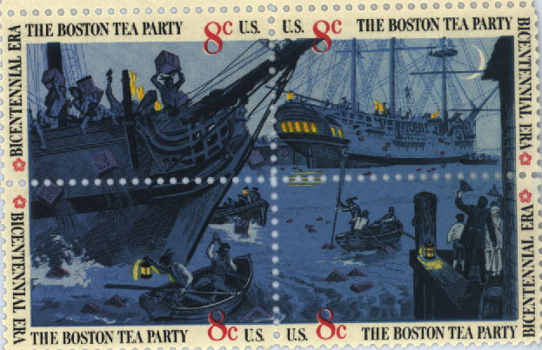
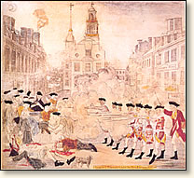
Trade Barriers: Tariffs
American Revolution
Notes:
Instructional Approach(s): The teacher can use the Boston Tea Party as an example of the use of tariffs.

Slide 6
Trade Barrier: Quotas
Quotas are limits on the amount of a good that can be imported into a country.
Quotas can cause shortages that cause prices to rise.
Notes:
Instructional Approach(s): The teacher should present the information on the slide while the students summarize the important information on their graphic organizer.

Slide 7
Trade Barrier: Embargos
Embargoes forbid trade with another country.
The United States had a trade embargo with South Africa during apartheid.
Notes:
Instructional Approach(s): The teacher should present the information on the slide while the students summarize the important information on their graphic organizer.

Slide 8
Trade Barriers: Embargos
Embargoes usually happen for political reasons. Because the United States does not want to support countries that may support terrorism, it has used embargos against Iran, Iraq, and Syria.
Notes:
Instructional Approach(s): The teacher should present the information on the slide while the students summarize the important information on their graphic organizer.

Slide 9
Trade Barrier Identification Activity
Notes:
Instructional Approach(s): Individually, with a partner, or as a class, students read different statements and decide whether they describe a tariff, quota or embargo.

Slide 10
Distributed Summarizing
On the bottom of your Trade Barrier Identification Activity sheet, answer the following scenario:
The Canadian Pear Growers Association is concerned about increased competition from imported pears that are larger than those grown within Canada’s borders.
The Association wants to lobby for a trade barrier. Some members think a tariff or quota would be most beneficial. Others disagree and suggest an embargo would be best. Which Trade Barrier Would You Recommend? Why?
Notes:
Instructional Approach(s): Individually, with a partner, or as a class, students read the scenario and decide which type of trade barrier would be recommended. Call on students or ask for responses. Take 2-3 minutes to discuss the situation with the class.

Slide 11
Summarizing Strategy
Answer the following questions on the Trade Barriers Response Sheet
Identify something in your life in which you would be willing to pay a tariff. Explain why.
Identify something in your life in which your parent or teacher might place a quota. Explain why.
Identify something in your life in which your parent or teacher might place an embargo. Explain why.
Notes:
Instructional Approach(s): Each student should complete the summarizer. The teacher should use the summarizer to determine the level of student mastery and if differentiation is needed.

